Slide 1
IMPLICATIONS OF ESG FOR
FIRM STRATEGY
Dr. Kwangsoo Kim
Konkuk University

Slide 2
Relationship b/w ESG and Firm Strategy
STRATEGY
ESG ENVIRONMENT
  General
  Industry
  Market
ORGANIZATION
Resources/Capability
Structure
Systems/processes
Culture
Leadership, etc.
PERFORMANCE
Financial
Nonfinancial

Slide 3
Integrating ESG into Firm Strategy
Business Portfolio Innovation
- Low to High
Corporate
Active
Business Model Innovation
- Low to High
Business
Passive
Functional Innovation (Focus)
- Low to High (Narrow to Broad)
Function
Passive
Active

Slide 4
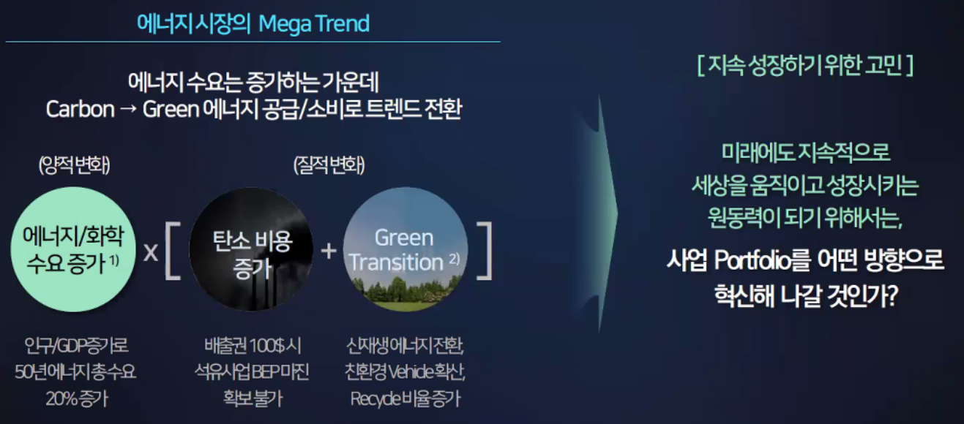
Integrating ESG into Firm Strategy
미래변화와 X사의 고민

Slide 5
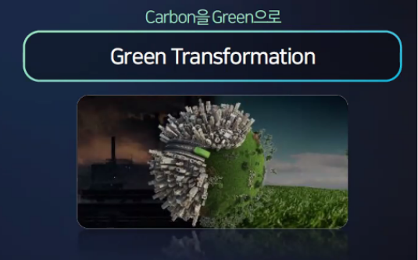


Integrating ESG into Firm Strategy
X사 변화방향: Green 중심 BM 혁신 및 Portfolio 혁신
(X사의 성장전략: Carbon to Green)

Slide 6
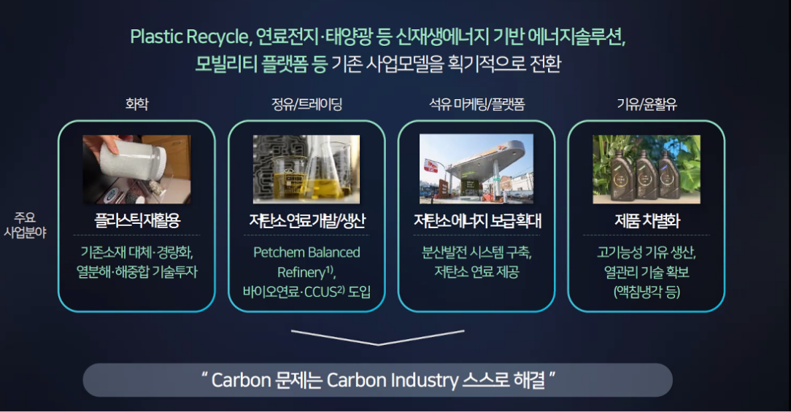
Integrating ESG into Firm Strategy
X사 변화방향: Green Transformation (BM 혁신)

Slide 7
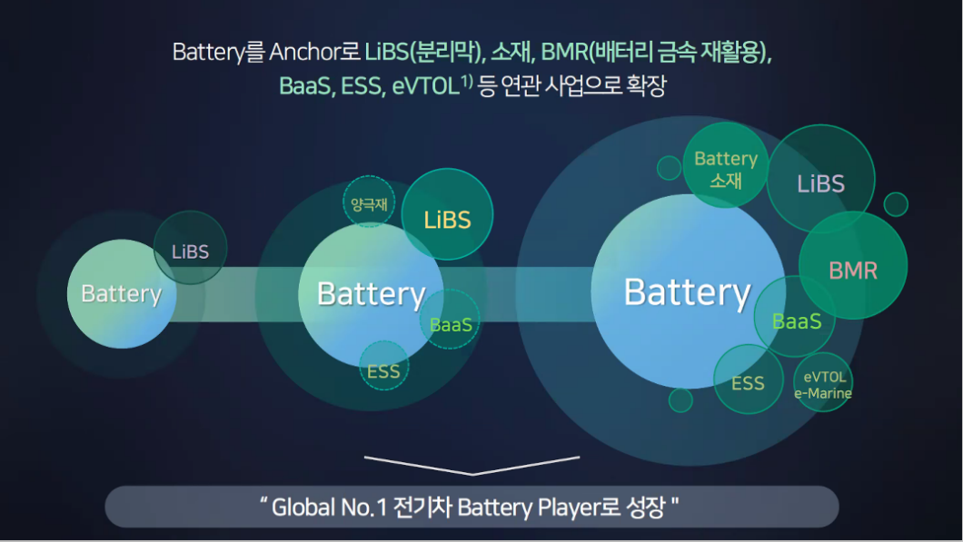
Integrating ESG into Firm Strategy
X사 변화방향: Green Anchoring (Portfolio 혁신)

Slide 8
Balance b/w Financial and Nonfinancial for Sustainability
Environment
Social
Financial
Governance

